Slide 1
Suomi NPP OMPS EV SDR Delta Review
Fred Wu, OMPS SDR Team Lead
June 3, 2014

Slide 2
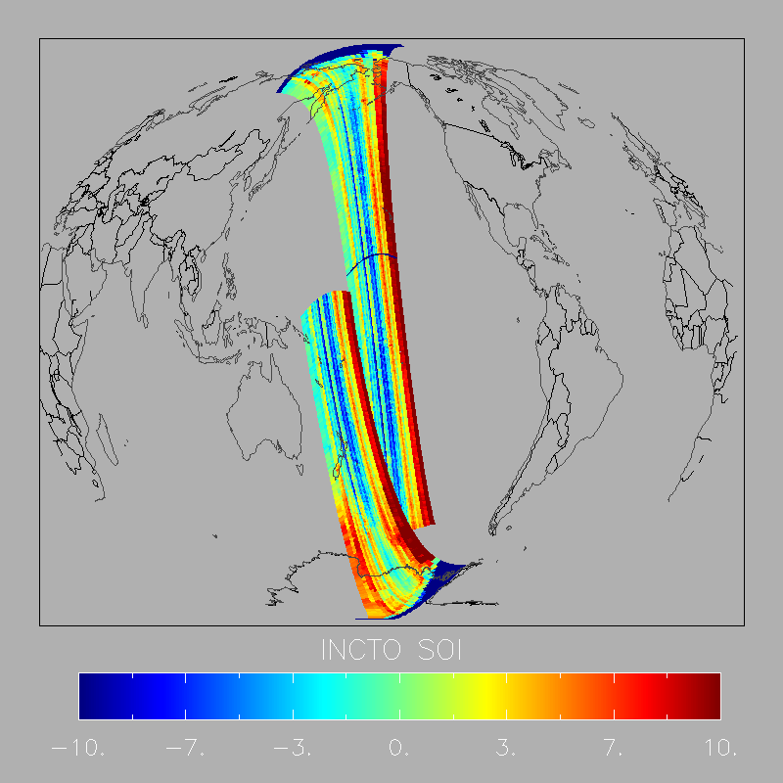
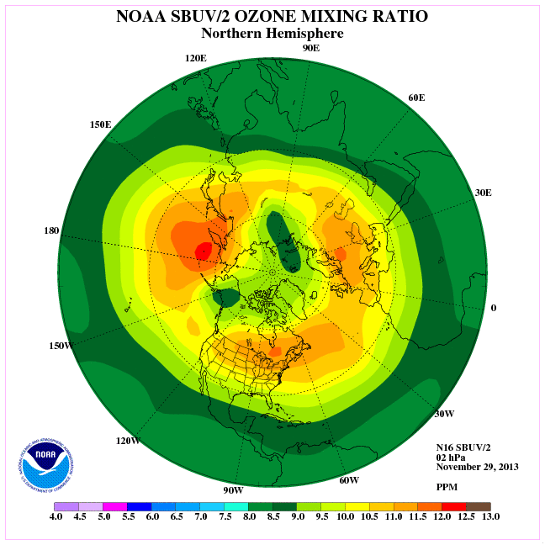
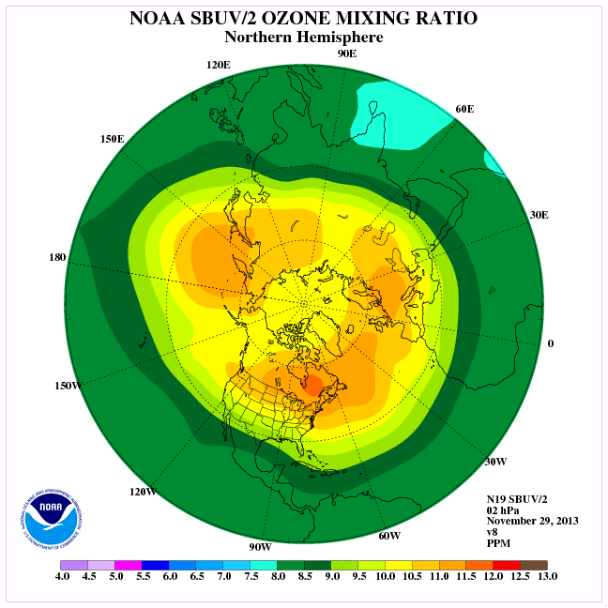
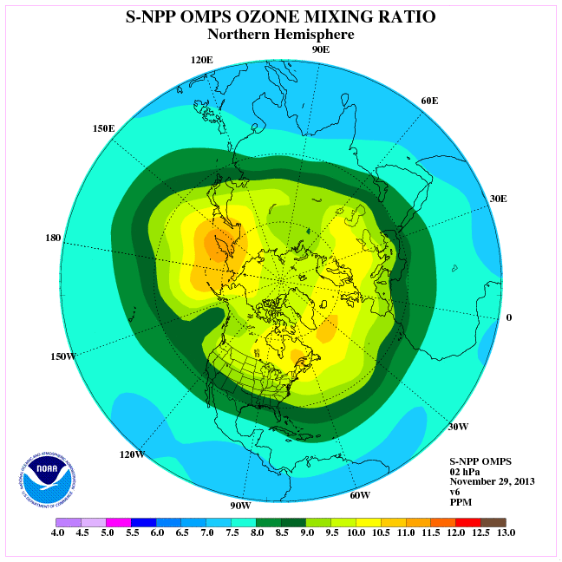
Remaining Issues from Dec 2013
OMPS instrument performance is excellent, but has remaining issues that need to resolved in OMPS EV SDR
Cross-track effects in NM need to be addressed.
SDR Team has a plan, needs to be implemented.
Some of these issues may be address by EDR algorithm
Wavelength Registration
Stray-light improvements still needed in NP SDR.
Stray Light Correction
Artificial separation between EV SDR and Cal SDR should be eliminated.
Cal SDR production in GRAVITE is a good solution. Why is it taking so long to implement?
CAL SDR Transition.

Slide 3
Wavelength Registration (1/3)
Notes:
SO₂ Index before (left) and after (right) soft calibration. (L. Flynn and T. Beck)

Slide 4
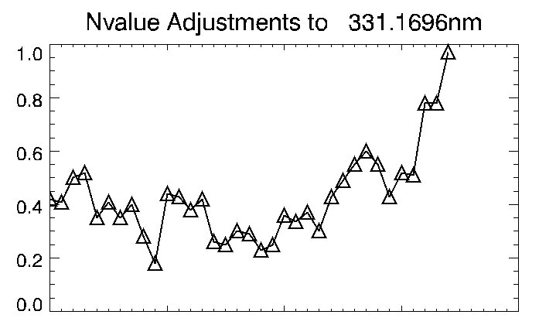
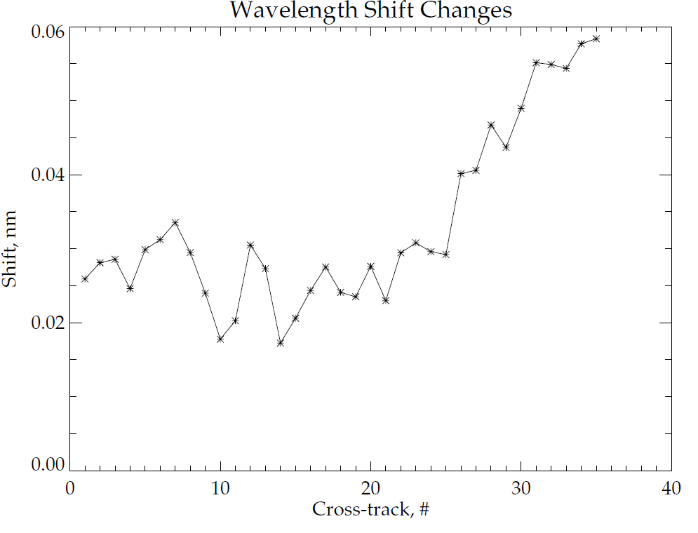
Wavelength Registration (2/3)
CCR 1192 (Mx8.2, 20 Feb 2014) shifted wavelength (X) that has similar effect of the soft calibration

Slide 5
Wavelength Registration (3/3)
DR 7654 & 7655 will update a LUT for NP (left) and NM (right) to minimize the required shift.

Slide 6
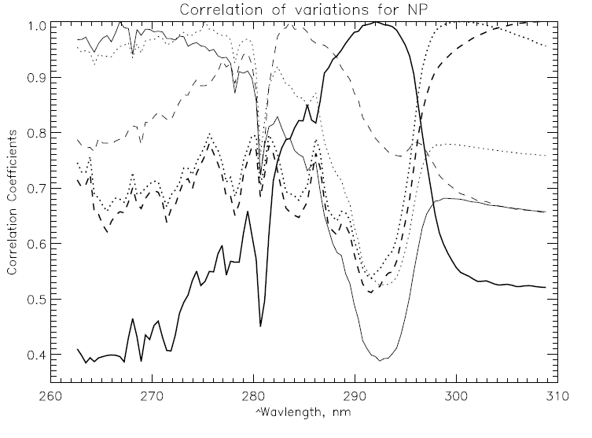
Stray Light Correction - NP
298 nm: 0.75 to 0.65 (goal is <0.3)
273 nm: 0.75 to 0.60 (goal is <0.3)
Before (left), After (right), and Goal (purple)
CCR 1249 (Mx8.3, 18 Mar 2014) corrected part of the NP stray light.
Further improvement is being investigated (DR 7623).

Slide 7
Improvements in O3MR due to addition of 252nm channel
Most noticeable improvements at 2 and 3 hPa.
The OMPS v6 o3mr at 2mb now looks very similar to the N19 SBUV/2 2mb analysis.
Further improvement with OMPS NP stray light correction.
*note that 2/01 is the same as 1/31 since there is no new obs for 2/01.

Slide 8
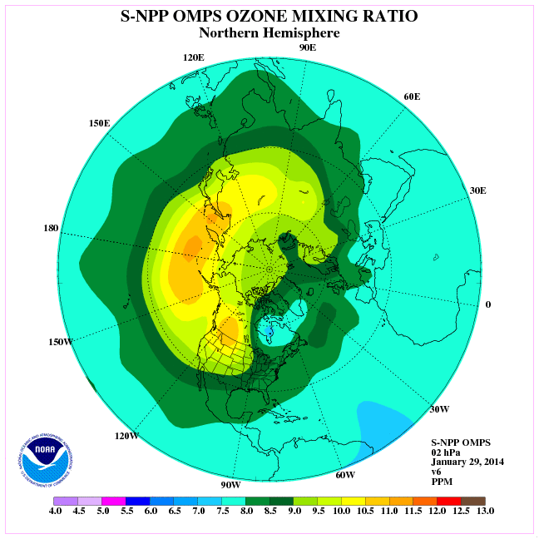
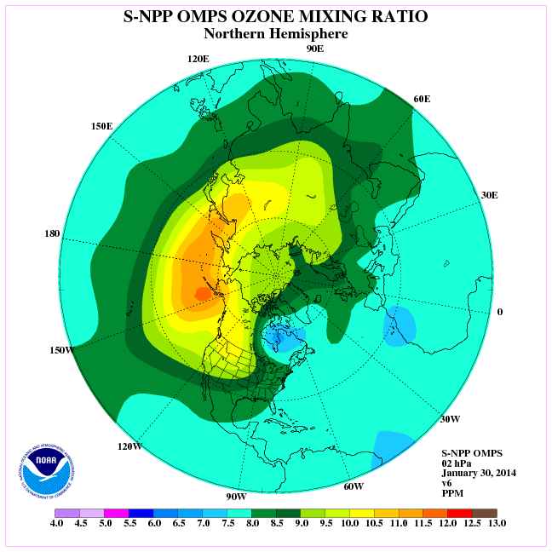
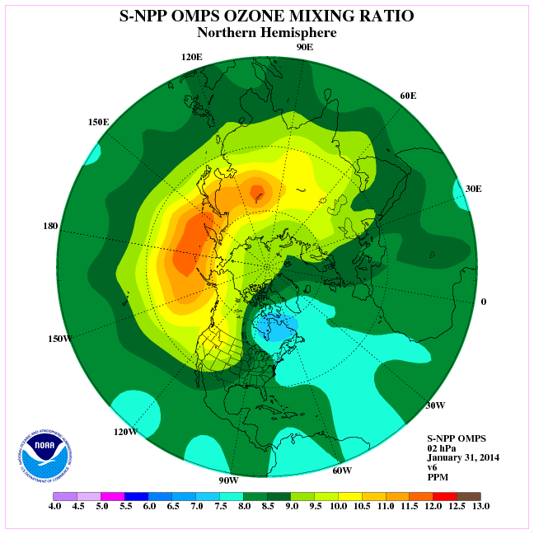
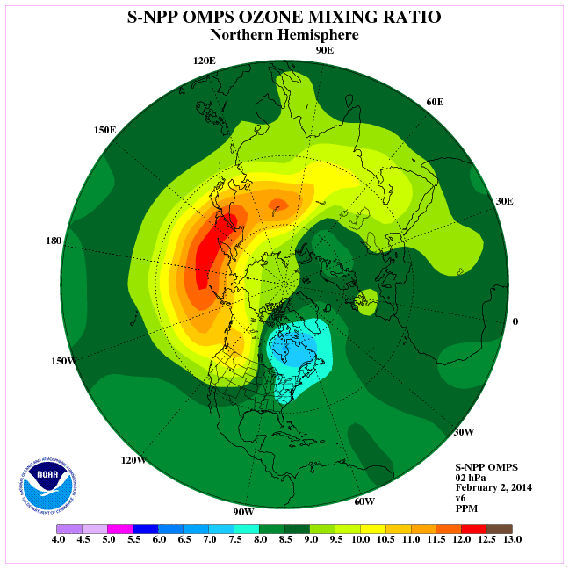
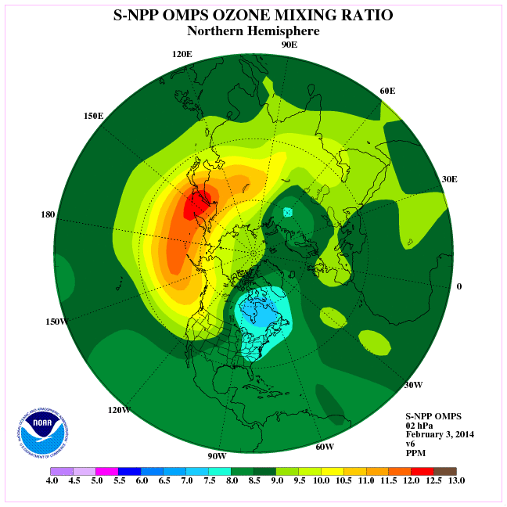
2mb
1/29
1/30
1/31
2/01
2/02
2/03

Slide 9
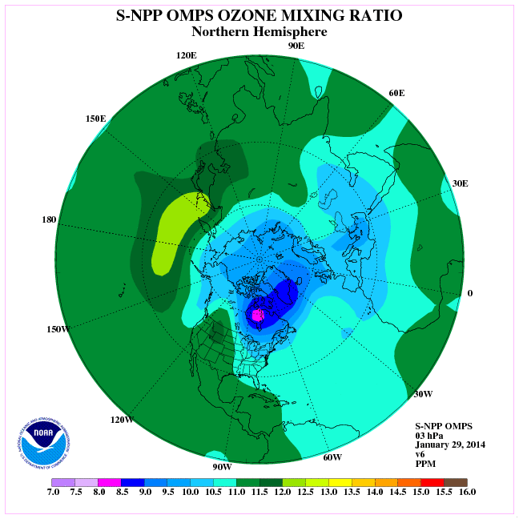
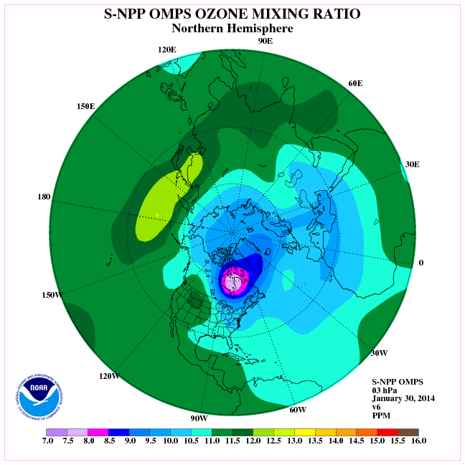
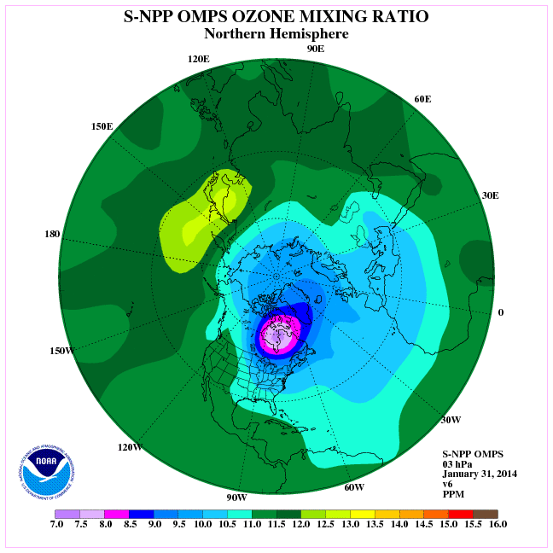
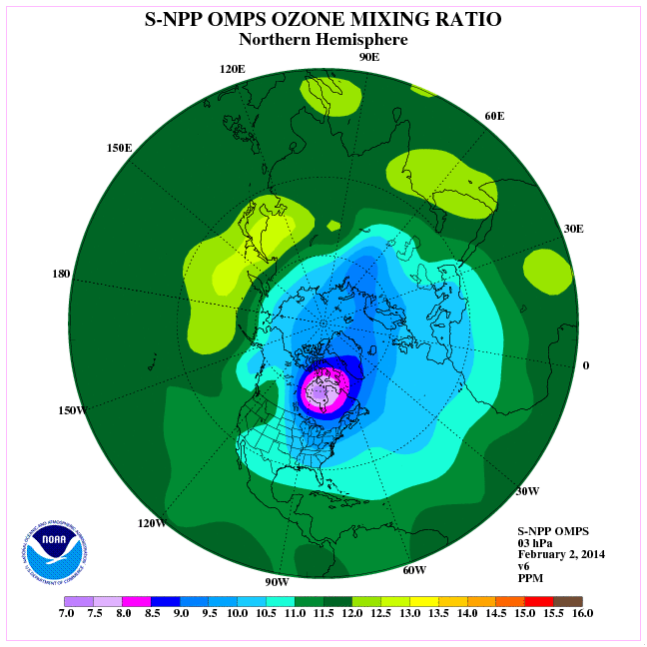
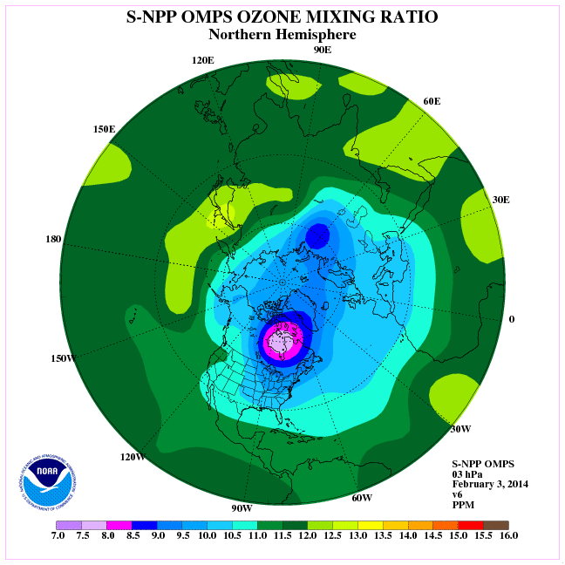
3mb
1/29
1/30
1/31
2/01
2/02
2/03

Slide 10
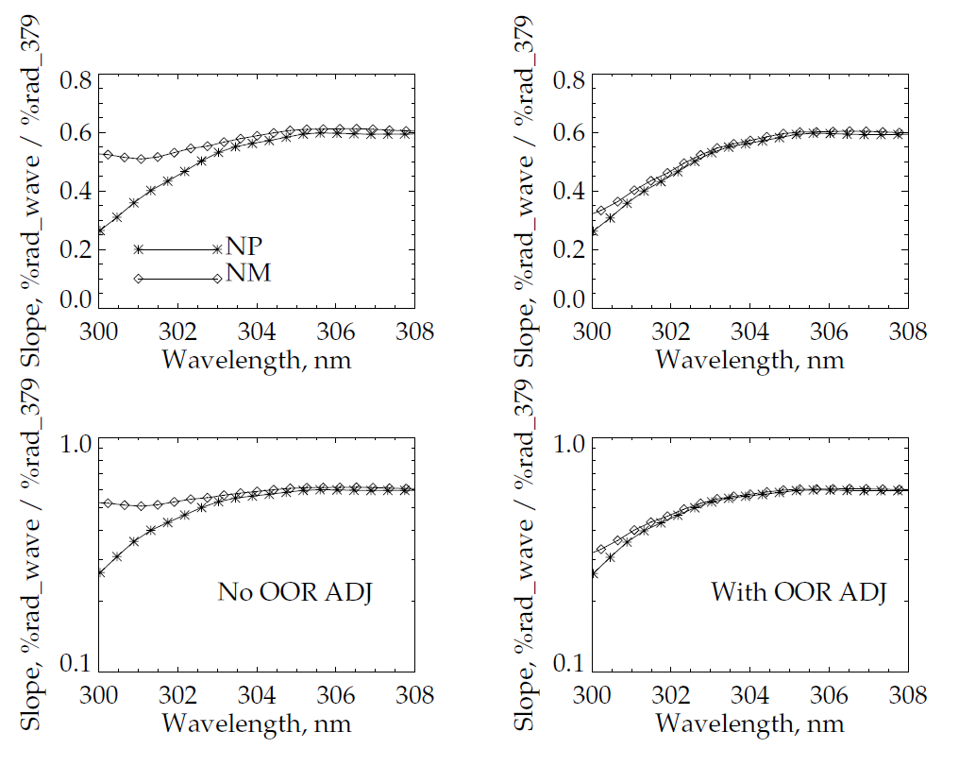
Stray Light Correction - NM

Slide 11
GRAVITE OMPS SDR Cal Integration Design Review April 17, 2014
CAL SDR Transition
Pat Purcell,
JPSS DPES SEI& T Manager

Slide 12
Documentation
ATBD – updated.
Users’ Manual – optional
Error Budget – updated

Slide 13
Other Improvements
DR 7315 (Revise bias correction to remove negative smear in NM) – CCR 1672- LUT update, out of cycle implementation expected by first week of July
DR 4818 (Revise bias correction to remove negative smear in NP) - CCR 1777 – LUT update, out of cycle implementation expected by first week of July
DR 7630 (Revise the incorrect use of 94 as spatial bin size in NP bias calculation) - CCR 1798 – under regressing testing. Expected AERB approval on June 4, 2014 and implementation in 8.6
DR 7014 (Modification of CDFCB dark fields)- Work under PCR – Expected implementation for 8.5
DR 7253 (Field modifications in the CDFCB for OMPS NP dark orbit and id information) - Work under PCR – Expected implementation for 8.5
DR 7613 (Obsolete QF for NM) - CCR 1766 – approved May 28
DR 7614 (Obsolete QR for NP) - CCR 1767- approved May 28

Slide 14
Path Forward
Suomi NPP
Instrument and SDR performance monitoring, characterization, and improvement.
Support instrument cal/val (e.g., orbit adjustment, anomaly resolution)
Complete documentation (Users’ Guide)
SDR software improvements
Stray light correction
Wavelength registration
Transition CAL SDR operation to GRAVITE.
JPSS J1
Analyze TVAC data and derive LUT for J1.
Develop science code for J1
More wavelength and higher data rate for EV SDR
New algorithm for CAL SDR
Test data (high resolution data from S-NPP)

Slide 15
Summary
With additional accomplishments since December 2013, the OMPS nadir EV SDRs are found to have
Characterized for on-orbit sensor performance
Defined SDR product uncertainties over a range of representative conditions
Adjusted calibration parameters accordingly, pending soft calibration that can be applied to validated SDRs
Plan for later improved version
Strong versioning with documentation
Been ready for use in applications and scientific publication
Request to declare that OMPS nadir EV SDR be Validated

